Slide 1


SMART INDIA HACKATHON 2026
Problem Statement ID- SIH26111
Problem Statement Title- Smart AI-Enabled
Rapid Feed and Silage Quality Testing
System for Dairy Farmers
Theme- Agriculture ,FoodTech & Rural
Development
PS Category- Software
Team ID-
Team Name- YuvaNova

Slide 2
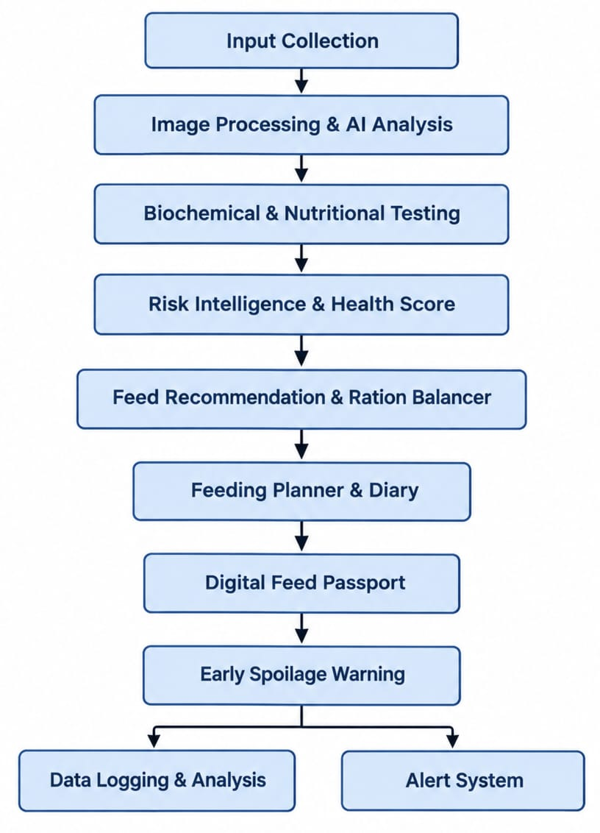
IDEA TITLE
YuvaNova
Proposed Solution:
How it Addresses the Problem :
Helps farmers identify poor-quality feed early.
Reduces guesswork in feed selection.
Warns about possible adulteration and spoilage.
Provides guidance in Telugu, Hindi, and English.
Innovation & Uniqueness
Combines AI, feed testing, and animal-specific recommendations in one platform.
Low-cost and software-based, without expensive equipment.
QR-based digital Feed Passport for tracking.
Early spoilage alerts using feed-quality history.

Slide 3
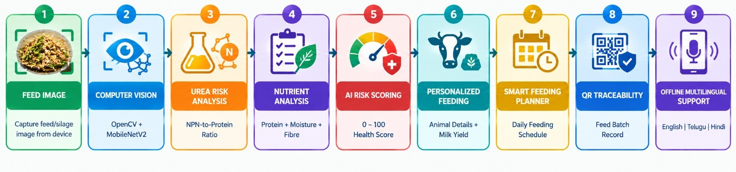
TECHNICAL APPROACH
YuvaNova
Computer Vision: OpenCV + MobileNetV2 for feed defect and spoilage detection.
Urea Risk Analysis: NPN-to-protein ratio for suspected urea adulteration.
Nutrient Analysis: Compare protein, moisture and fibre with BIS/ICAR standards.
AI Risk Scoring: Generate a 0–100 SmartFeed Health Score.
Personalized Feeding: Recommend ration based on animal details and milk yield.
Smart Planning: Create daily feeding schedules and track feeding history.
QR Traceability: Generate QR-based feed batch records.
Offline & Multilingual: FastAPI + SQLite with English, Telugu and Hindi support.

Slide 4
FEASIBILITY AND VIABILITY
YuvaNova
Feasibility:
Low-cost and software-based — no expensive equipment needed.
Works on basic devices and offline.
Uses existing AI models and datasets.
Challenges & Risks:
Image quality may affect AI results.
Photos alone cannot confirm chemical toxins.
Different feed types may give different results.
Mitigation Strategies:
Use image preprocessing and fallback methods.
Train with more real-world feed samples.
Compare results with BIS & ICAR standards.
Clearly recommend lab testing when needed.

Slide 5
IMPACT AND BENEFITS
YuvaNova
Impact:
Farmers: Better animal health and reduced feed-related losses.
Dairy Industry: Supports better milk production through balanced feeding.
Rural Communities: Makes feed quality checking simple and affordable.
Benefits:
Social: Healthier livestock and easier access to useful farming guidance.
Economic: Reduces losses from spoiled/adulterated feed and unnecessary testing costs.
Technological: Provides low-cost AI screening, multilingual support, and QR-based feed traceability.

Slide 6
RESEARCH AND REFERENCES
YuvaNova
BIS IS 2052:2023 – Compounded Feeds for Cattle.
ICAR Dairy Animal Nutrition Guidelines – Animal feeding and ration recommendations.
Mendeley Grain Defects Dataset – Feed defect classification.
Silage Quality Dataset – Fresh and spoiled silage detection.
OpenCV & MobileNetV2 – AI-based feed image analysis and defect detection.
NPN/Urea Stoichiometric Model – Suspected urea adulteration risk screening.

